Slide 1
Algorithmic Management

Slide 2
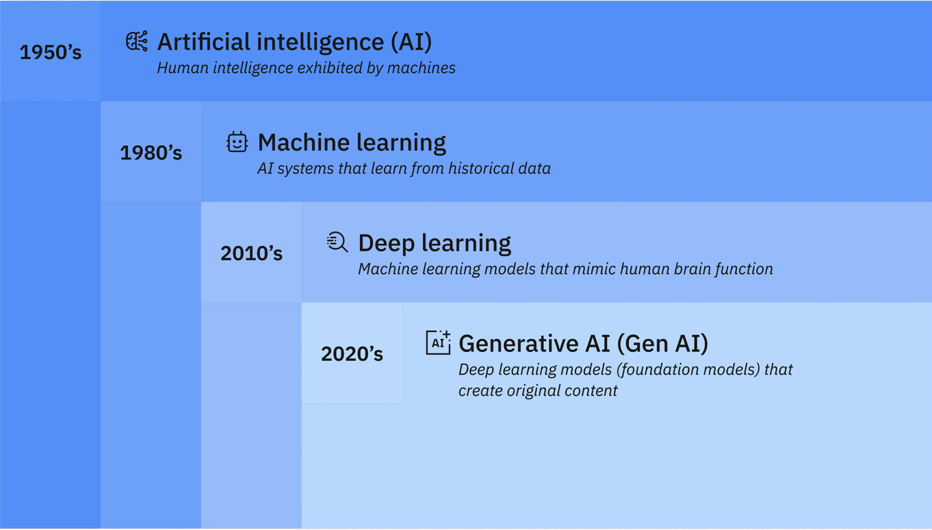
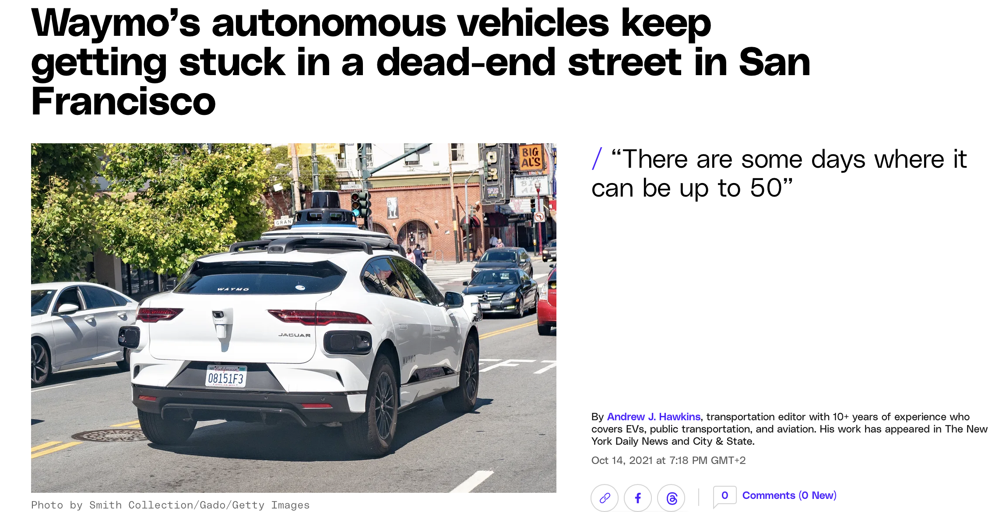
Artificial intelligence
Human intelligence: The ability to perform suitable techniques to solve problems and achieve goals, appropriate to the context in an uncertain, every-varying world
“The science and engineering of making intelligent machines”
McCarthy J., What is artificial intelligence?, Stanford University, 1955
Simulate human learning, comprehension, problem solving, decision making, creativity and autonomy
Source: https://www.ibm.com/topics/artificial-intelligence

Slide 3
Algorithm v. AI
Algorithms:
Step-by-step instructions or sets of rules designed to solve specific problems or perform tasks
Typically deterministic, following a predefined path (do not learn from data)
Aim to efficiently solve a particular problem or task and are generally fixed in their operations once designed
AI:
Simulate human intelligence and perform tasks that would otherwise require human cognitive functions (i.e. learning, decision-making)
Can analyze vast amounts of data and adapt their behavior over time (learn and improve without being explicitly reprogrammed for each new task)
Aims to enable machines to mimic or simulate aspects of human intelligence, with the flexibility to handle complex, variable tasks and respond to new situations autonomously
In AI systems:
Algorithms provide the steps, while AI provides the intelligence to adapt, learn, and sometimes create new ways to solve problems autonomously.
Much of their behaviour emerges via learning from data or experience
GOAL:
For both: automating tasks that would otherwise be performed by humans
In AI systems: the decision itself could be delegated to the machine

Slide 4
Algorithmic Management of Work Relations
Systems of varying degrees of complexity, including:
Prolific data collection and surveillance of workers through technology;
Real-time responsiveness to data that informs management decisions;
Automated or semi-automated decision-making;
Transfer of performance evaluations to rating systems or other metrics
Asymmetry of information
Reshaping of employment relationships by progressively replacing the managerial functions
Augmentation of traditional employer’s functions
Hiring | Direction | Evaluation | Discipline
Screening Offering | Recommending | Recording Rating | Replacing Rewarding

Slide 5
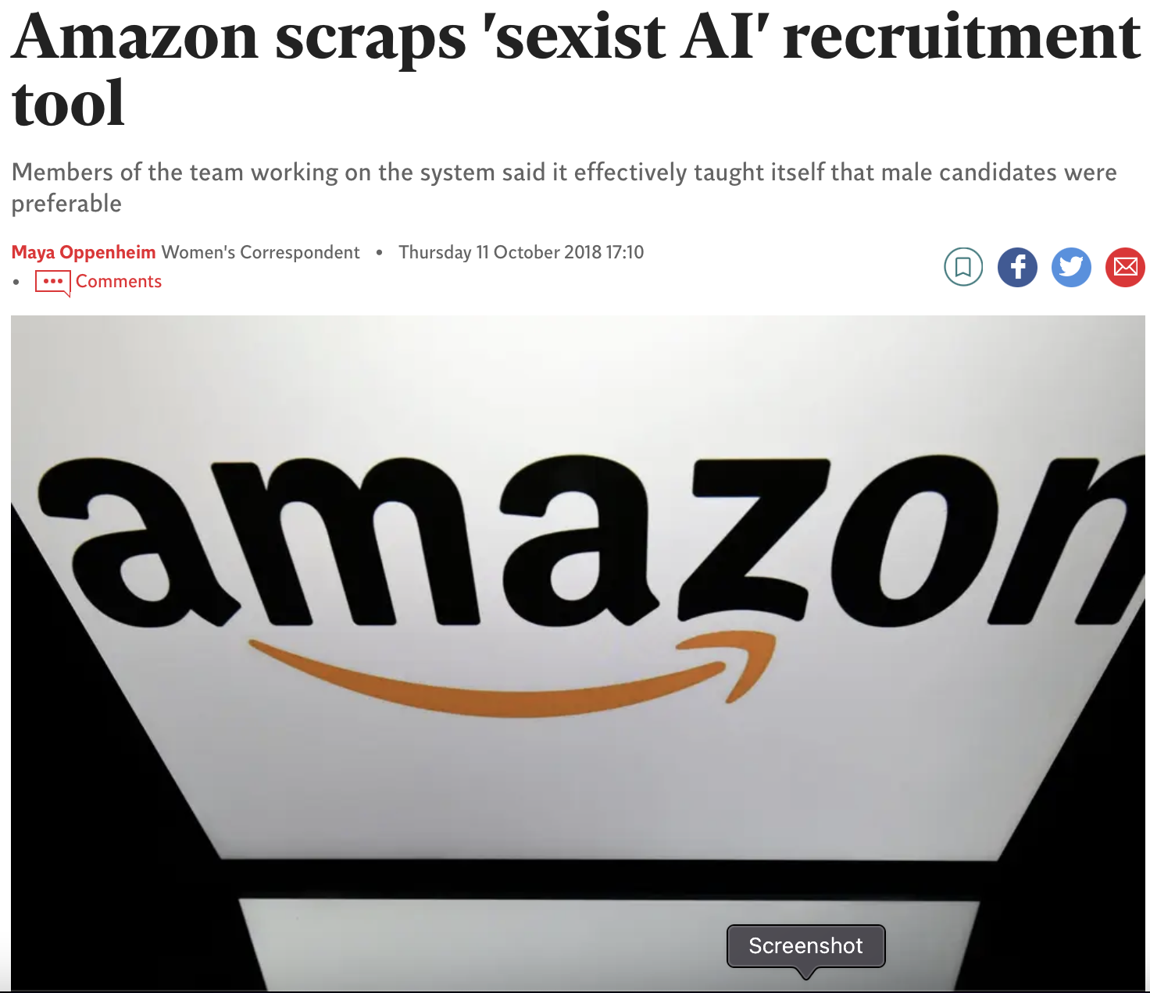
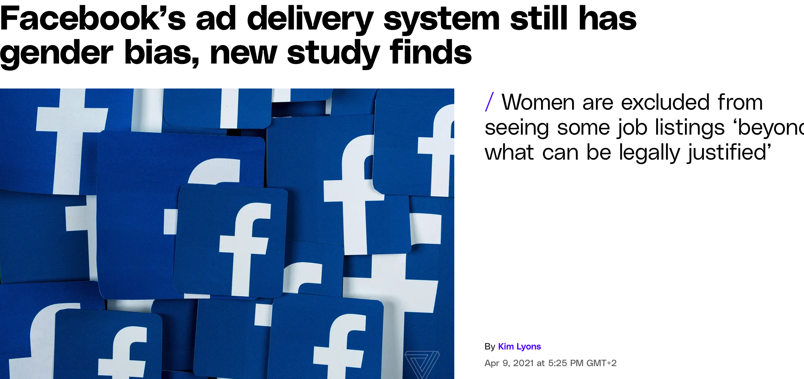
Management of the various stages
of employment relationships
Selection and hiring process
AI-driven software allows:
Creation of job descriptions
Screening on applications (CV, career, education), shortlist
Determination of offers, including salaries
Weight of former ratings
Grant more objectivity than Humans
Is it true?

Slide 6
Day-to-day management of workers
Overwork
Productivity and more job satisfaction
Task and working time allocation
Frustration
Recommending decisions
Recommending specific courses of action
Can bypass the heuristics workers typically use to make decisions
Frustration and Stress
Can provide rewards in real time for behaviors that comply with predefined correct behaviors
Interactively and dynamically rewarding

Slide 7
Employees’ supervision
Violation of Privacy
Stress
Lack of transparency
Discrimination
Algo Recording (Capture employees’ digital activities, information about phone calls, emails and other communication channels)
Recording and aggregate finely grained behaviuor and statistics from internal and external sources
Providing real-time feedback
Algorithmic rating
Using online rating and ranking
Using predictive analytics
Can track a wide range of behaviors
Can enable real-time adjustments of worker performance
Can aggregate quantitative and qualitative data to measure work productivity and evaluate workers
Can predict future worker performance—achievement, skills, retention, etc.

Slide 8
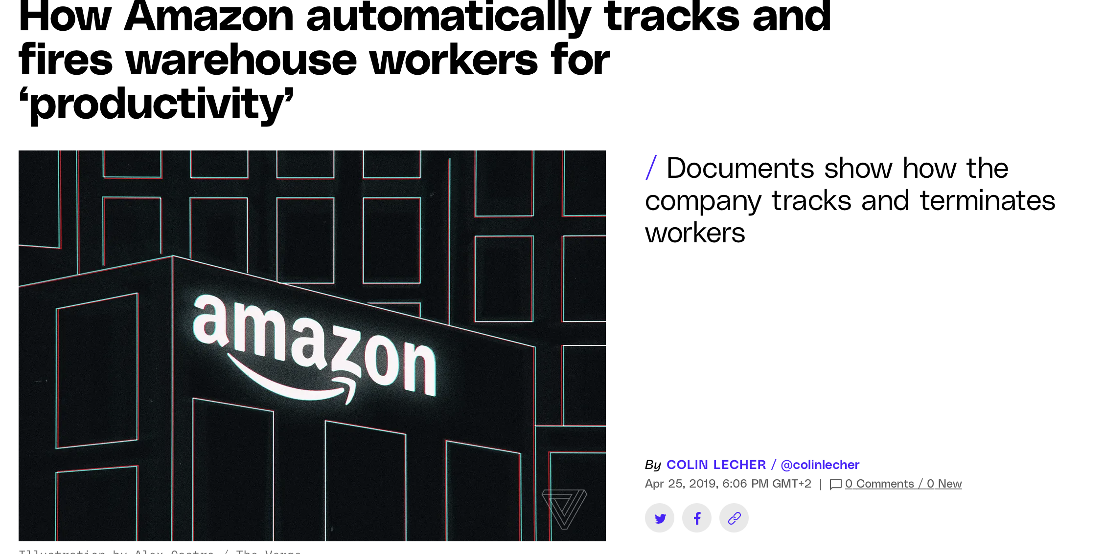
Sanctioning and Termination of the employment relationship
Sense of precarity
- Can be used to fire underperforming workers and replace them with others who may better follow managerial directives
Automatically replacing or removing

Slide 9
EU Legislative Responses
Development and deployment of AI tools
Applications in the workplace
AI Act
Anti-discrimination law
Regulation no. 2016/679 (GDPR)
Directive on platform work

Slide 10
GDPR
Right to object
Art. 21.1 and 22.1 GDPR – Right not to be subject to fully automated decision-making that produces legal effects on her
Right to Human interface
Art. 22.3 GDPR - the data subject (the worker) has at least the right to obtain human
intervention on the part of the controller (the employer).
the right to express his or her point of view (to obtain an explanation) and to contest the decision.
Art. 22.2 GDPR
- Not applicable if necessary for entering into, or performance of, a contract between the data subject and a data controller
- Based on a compelling legitimate ground
In any case
Justification based on the needs of the employment contract
A business advertises an open position. It receives tens of thousands of applications. Due to the exceptionally high volume of applications, the business may find that it is not practically possible to identify fitting candidates without first using fully automated means to sift out irrelevant applications. In this case, automated decision-making may be necessary in order to make a short list of possible candidates, with the intention of entering into a contract with a data subject

Slide 11
Right to be informed
Art. 15.1.h GDPR - A data subject has the right to obtain information about the existence of (fully) automated decision-making, including profiling, and to receive meaningful information about the logic involved, as well as the significance and the envisaged consequences of such processing
It may be challenging to understand how an automated decision-making process or profiling works
Directive on Platform Work

Slide 12
Right to information regarding
automated monitoring systems (supervision and evaluation of work)
automated decision-making systems
(taking or supporting decisions affecting working conditions, such as assignments, earnings, safety and health, working time, promotion, suspension or termination)
Information shall concern
-The system is in use
- The categories of actions monitored or evaluated
The system is in use
The categories of decisions that are taken or supported
Parameters they consider
The grounds for decisions affecting the worker’s account or payment
Information shall be given to
Workers’ representatives and
national labour authorities, upon request
May be in electronic format, presented in a concise, transparent, intelligible and easily accessible form, using clear and plain language”
Workers on first working day (latest)

Slide 13
Platforms/Employers should regularly monitor and evaluate the impact of individual decisions taken or supported by automated monitoring and decision-making systems on working conditions (H&S in the first place)
Human monitoring
necessary competence, training and authority
Protection against retaliation
Workers can obtain explanations for significant decisions affecting their working conditions
Right to request the digital labour platform to review that decision (within one week)
Right to challenge the decision and claim for ad adequate compensation in case of violation of rights
Contact person (algorithmic management officer)
- necessary competence, training and authority
Information and consultation of platform workers’ representatives on decisions likely to lead to the introduction of or substantial changes in the use of automated monitoring and decision-making systems

Slide 14
Anti-Discrimination Law
Visible discriminations: Algorithm needs inputs
- Inputs can include prohibited ground for discriminations: i.e. the code excludes pregnant women
Hidden discrimination: lack representativeness in the data used when algorithm learns by examples
if data mining treats cases in which prejudice has played some role as valid examples to learn from, that rule may simply reproduce the prejudice involved in these earlier cases
Defining the model or the result that algorithm should reach (i.e. the good employee, evaluating the absenteeism rate)
‘Frank’ the algorithm

Slide 15
Visible and hidden discriminations may be prohibited as they are …
Direct Discriminations
A situation in which ‘one person is treated less favourably than another is, has been or would be treated in a comparable situation on the basis of one of the protected grounds defined in the relevant directives’ [Sex/Gender, Racial or Ethnic Origin, Religion or Belief, Disability, Age, Sexual Orientation, Nationality, Political Opinion, Social Origin]
It is prohibited for an algorithm to choose not to recruit women, migrants, young people, etc...
Component of algorithms should be accessible to detect the discrimination.
Indirect Discriminations
A situation where an apparently neutral provision, criterion or practice would put [members of a protected category] at a particular disadvantage compared with other persons, unless that provision, criterion or practice is objectively justified by a legitimate aim and the means of achieving that aim are appropriate and necessary.
It takes into account the output produced by the algorithm. If the output reveals a particular disadvantage for a protected category, it must be scrutinised.

Slide 16
GDPR and Discriminations
I.e. In French law companies are asked to only examine anonymous CVs to select job applicants for interview (omitting information, such as name, ethnic origin, age, gender and address) so that algorithms cannot take into account these criteria.
1) Minimisation
The algorithm should not be overfed with personal data
Article 5 GDPR: the personal data shall be ‘adequate, relevant and limited to what is necessary in relation to the purposes for which they are processed’
Article 9 GDPR: (sensitive data can easily lead to discrimination) ‘processing of personal data revealing racial or ethnic origin, political opinions, religious or philosophical beliefs, or trade union membership, and the processing of genetic data, biometric data for the purpose of uniquely identifying a natural person, data concerning health or data concerning a natural person’s sex life or sexual orientation shall be prohibited’
2) Transparency
Employees must be informed about the data processed and their sources, as well as about the purpose of the algorithm and the way it is implemented.
Several provisions of GDPR: a right to be notified and not to be subject to solely automated decision-making; access to meaningful information about the logic involved; a right to be informed of the significance of and envisaged effects of solely automated decision-making;
When automated decision making is admitted: right to contest a decision, to express one ’s point of view, and to human intervention

Slide 17
AI Act

Slide 18
Targets
Article 1.1. “The purpose of this Regulation is to improve the functioning of the internal market and promote the uptake of human-centric and trustworthy artificial intelligence (AI), while ensuring a high level of protection of health, safety, fundamental rights enshrined in the Charter, including democracy, the rule of law and environmental protection, against the harmful effects of AI systems in the Union and supporting innovation”
Preventing risks for rights and security (health, safety, privacy, human dignity, workers’ rights, etc)
Benefits for the economy and the society
Human-centric approach

Slide 19
Scope of application
Machine learning, computer vision, natural language processing and understanding, intelligent decision-support systems, etc.
Definition of AI System (Article 3):
A machine-based system that
is designed to operate with varying levels of autonomy and that may exhibit adaptiveness after deployment, and that,
for explicit or implicit objectives, infers, from the input it receives, how to generate outputs such as predictions, content, recommendations, or decisions that can influence physical or virtual environments
Traditional software systems or programming: rules defined solely by humans, even though they may automatically execute operations

Slide 20
Minimum Rules for Harmonization Approach
AI Act should be without prejudice to existing or new Union Laws and National Laws which are more favourable to workers
GDPR
Platform Workers Directive
Anti-Discrimination Directive
Charters of Fundamental Rights
Union Laws on
Workers’ protection
data protection
consumer protection
fundamental rights
product safety
National Laws on
- Fundamental rights
- Workers’ protection
More
favourable
AI Act

Slide 21
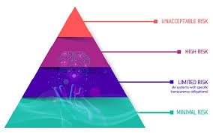
Risks-evaluation
Appropriate mitigation
Risks-based approach

Slide 22
Unacceptable Risk
Contradict the fundamental values and principles of the EU, such as respect for human dignity, democracy, and the rule of law.
It shall be prohibited the placing on the market and putting into service of AI systems such as:
Social scoring, i.e., evaluating or classifying individuals or groups based on social behaviour or personal traits, causing detrimental or unfavourable treatment of those people (i.e. access to employment).
Create or expand facial recognition databases through the untargeted scraping of facial images from the internet or CCTV footage
Infer emotions of a natural person in the areas of workplace [access to employment and during the employment relationship] and education institutions, except where the use of the AI system is intended to be put in place or into the market for medical or safety reasons.
These systems are either prohibited or subject to strict restrictions

Slide 23
Can have a significant effect on fundamental rights or the safety of individuals
High Risk
Employment, workers management and access to self-employment:
Recruiting process
(a) AI systems intended to be used for the recruitment or selection of natural persons, in particular to place targeted job advertisements, to analyse and filter job applications, and to evaluate candidates;
Employment relationship management
(b) AI systems intended to be used to make decisions affecting terms of work-related relationships, the promotion or termination of work-related contractual relationships, to allocate tasks based on individual behaviour or personal traits or characteristics or to monitor and evaluate the performance and behaviour of persons in such relationships.
Exception:
Shall not be considered to be high-risk where it does not pose a significant risk of harm to the health, safety or fundamental rights of natural persons, including by not materially influencing the outcome of decision making.
(a) the AI system is intended to perform a narrow procedural task
(b) the AI system is intended to improve the result of a previously completed human activity
(c) the AI system is intended to detect decision-making patterns or deviations from prior decision-making patterns and is not meant to replace or influence the previously completed human assessment, without proper human review

Slide 24
High Risk
Most of AI employment tools are based on profiling, thus to be considered as High Risk
AI system performs profiling of natural persons shall always be considered to be high-risk
Automated Processing powered by AI, that analyze large amounts of personal data
Personal Data could include anything that identifies or is associated with an individual, such as demographic information, browsing behavior, purchase history, biometric data, or social media interactions
Evaluation or Prediction: about certain aspects of a person. These aspects can range from: Behaviors, Preferences, Characteristics (like personality, reliability, work performance)
Automated Decision-Making: predict job applicants’ suitability for specific roles; tasks assignation; dismissals

Slide 25
Obligations for High-Risk Systems
Providers and Deployers
Unacceptable risk
Limited or minimum risk
Rank the risk
High risk
DEPLOYERS/EMPLOYERS
Comply with obligations to ensure safety
Comply with Instructions
Human oversight
PROVIDERS
Impact Assessment
Information and consultation
Transparency and Information

Slide 26
Providers
Adopting data governance measures (ensuring that data is accurate, consistent, secure, used ethically in compliance with regulatory requirements)
Registering high-risk AI systems in an EU-wide database
Undergoing conformity assessment procedures to ensure that the technology complies with predetermined requirements
Implementing enhanced risk management
Harm to the health, safety or fundamental rights of natural persons shall be evaluated and counteracted risks to such rights.
Workers’ health and safety, personal data, dignity

Slide 27
Providers conformity assessment
AI systems are parts of already tested products (i.e. medical devices, toys)
AI are stand-alone products
No obligations
Internal conformity assessment (self-assessment)
External auditor (notified body)
Following non-mandatory
standards developed by European standard development organization (CEN, CENELEC) in conjunction with international organizations (ISO, IEC)
Desirable Trade Unions involvement

Slide 28
Providers Transparency and Provision of Information to Deployers
Instructions include:
the characteristics, capabilities and limitations of performance of the high-risk AI system, including:
(i) its intended purpose;
(ii) the level of accuracy, including its metrics, robustness
(iii) any known or foreseeable risk, including to the health and safety or fundamental rights
its performance regarding specific persons or groups of persons on which the system is intended to be used;
information to enable deployers to interpret the output of the high-risk AI system and use it appropriately;
the human oversight measures, including the technical measures put in place to facilitate the interpretation of the outputs of the high-risk AI systems by the deployers;
Design and develop AI systems in a way that ensures their operation is sufficiently transparent to enable deployers to interpret a system’s output and use it appropriately
Give the deployer the instructions for the use of the AI system, containing “concise, complete, correct and clear” information in a format that is “accessible and comprehensible to deployers”

Slide 29
Deployers (Employers)
In compliance with Workers’ fundamental rights:
Article 8 CFREU: Privacy
Article 21 CFREU: Non-Discrimination
Article 31 CFREU: Dignity, Health and Safety
Decisions to implement AI tools are granted under the freedom to conduct a business (article 16 CFREU)
AI Act
Article 26(1): Deployers shall take appropriate technical and organisational measures to ensure they use such systems in accordance with the instructions for use accompanying the systems
Liability for misuse (i.e. the employer actual use differs from provider’s intended purpose)
Article 26(2): Deployers shall assign human oversight to natural persons who have the necessary competence, training and authority, as well as the necessary support
Further developed by Platform Work Directive
Human-in-command principle

Slide 30
Deployers (Employers)
AI Act article 26: Deployers shall monitor the operation of the high-risk AI system. If a risk to fundamental rights arises, they shall inform the provider or distributor and the relevant market surveillance authority, and shall suspend the use of that system
Directive 89/391 H&S
Employers must develop a coherent and comprehensive prevention policy which encompasses all possible risks. Therefore:
Employers must elaborate a prevention policy that verifies and assesses the risks associated with the introduction of AI tools in the workplace
provide proper training to ensure that workers can use the technology safely
Fundamental Rights Impact Assessment
Based on Instructions received from the Producer
Article 35 GDPR: When automated or AI-assisted decisions involve data processing, employers shall undertake the Data Protection Impact Assessment (DPIA):
Identify and Assess Risks: Analyze how the processing could impact individuals’ privacy and data protection rights.
Identify Measures to Address Risks: Propose actions to mitigate or eliminate risks, such as data minimization, encryption, or anonymization.

Slide 31
Deployers (Employers)
Transparency and information
Workers’ representatives and affected workers:
Shall be informed before putting into service or using a high-risk AI system at the workplace.
Platform Workers Directive
Right to information and consultation of platform workers’ representatives on decisions likely to lead to the introduction of or substantial changes in the use of automated monitoring and decision-making systems
Any affected person subject to a decision which is taken by the deployer on the basis of the output from a high-risk AI system and which produces legal effects or similarly significantly affects that person in a way that they consider to have an adverse impact on their health, safety or fundamental rights (i.e. discrimination):
shall have the right to obtain from the deployer clear and meaningful explanations of the role of the AI system in the decision-making procedure and the main elements of the decision taken.
+ right to object, to human interface, to contest the decision

Slide 32
Can influence users' rights or decisions, but to a lesser extent than high-risk systems
Limited Risk
Examples:
AI systems used to generate or manipulate audiovisual content (such as deepfakes)
Provide personalized suggestions (such as chatbots)
AI-powered conversational model (Chat GPT)

Slide 33
Limited Risk
They must comply with transparency requirements, which involve the obligation to:
inform users that they are interacting with an AI system
provide relevant information about its characteristics and limitations.
This allows users to exercise their right to choose whether or not to rely on the AI system and to understand the possible consequences of their choices.
Developers and users of such systems must also ensure that the information provided is clear, understandable, and accessible.
AI systems with minimal or no risk are not subject to any specific regulatory obligations, but they must still comply with the general laws and regulations applicable to AI, such as those related to data protection, intellectual property, competition, civil liability, or consumer rights.

Slide 34
Group Work
Develop an AI Tool to Assist HR Departments in Managing Employment Relationships While Ensuring Compliance with EU Regulations (GDPR, AI Act, Platform Workers Directive) considering both the roles of providers and deployers, in light of the responsibilities to ensure compliance with EU regulations.
PROVIDERS
- Identify key challenges in managing employment relationships where AI can provide value (e.g., recruitment, performance monitoring, management of tasks, working hours, rewarding, dismissals).
- Conduct a risk assessment based on the EU AI Act risk categories. Explain why a certain category has been selected (most likely High-Risk)
- Develop a data governance strategy ensuring GDPR compliance: Minimization.
- Implement enhanced risk management
- Ensure transparency, give the deployers the instructions for the use of the AI system
- Propose measures for continuous monitoring and accountability of the AI system.
DEPLOYERS
- Take appropriate technical and organisational measures in accordance with the instructions
- Information for workers, unions, labour inspectors as for automated monitoring and decision making systems
- Human monitoring – Fundamental Rights Impact assessment based on providers instructions

